Slide 1
An Examination of the Geographic Aggregation of Catastrophic Risk*
Randy Dumm, Florida State University
Mark Johnson, University of Central Florida
Charles Watson, Watson Technical Consulting
2013 CICIRM Meeting
Kunming, China
*Based on a research project funded by the Florida Catastrophic Storm Risk Management Center at Florida State University

Slide 2
Catastrophic Exposures and Risk Bearing
Earthquake
  California but much broader exposure
  Tidal Wave/Tsunami
Windstorm and Storm Surge
  Hurricane/Tornadoes
  Coastal and Inland
Flood
  Rainfall driven
  Wind driven- Storm Surge
  Tsunami
Terrorism
Pandemics
Catastrophes and Risk Bearing (U.S.)
  State: Private market, E&S, Residual market
  Federal: Flood, Terrorism (ex-post financial support)

Slide 3
Federal Catastrophe Fund
Proponents
  Financial strength of federal government
  Pool risks that are uncorrelated or have low correlation
  Eliminate or reduce market dysfunctions
    Coverage availability
    Prompt claims payments
  Eliminate or reduce underinsurance problem
  Feds provide support ex-post anyhow!
Opponents
  Intrusion into private market
  Concerns about governmental inefficiencies (e.g., NFIP performance)
  Verification and triggers
  “Why should [INSERT YOUR STATE HERE] pay for California earthquake losses/Florida hurricane losses/Texas hurricane losses/New York –New Jersey wind and flood losses??”
    The subsidy problem
  Path to unwanted federal regulation of insurance

Slide 4
Motivation
Public policy debate about shifting additional catastrophic risk to the federal level
  ongoing and often contentious
  Little in the way of empirical analysis
Research Questions:
  Do diversification benefits exist by aggregating catastrophic loss over larger geographic areas?
  If so, when and to what degree do these benefits exist?
First Phase of Research
  Catastrophic Wind and Related Exposures (Coastal)

Slide 5
Selected Literature Review on Geographic Diversification
Lin and Wen (NAAJ, 2012)
  Relationship between ERM adoption and reinsurance or geographic diversification.
Klein and Wang (JRI, 2009)
  Catastrophic risk financing in the US and EU
Harrington (JRI, 2009)
  Financial crises and systemic risk
Klein and Krohm (JIR, 2008)
Jaffee and Russell (JRI, 1998)
Notes:
Lin, Yijia; Wen, Min-Ming; Yu, Jifeng. North American Actuarial Journal16. 1 (2012). ENTERPRISE RISK MANAGEMENT: STRATEGIC ANTECEDENTS, RISK INTEGRATION, AND PERFORMANCEOur results show that insurers with more reinsurance purchase and greater geographic diversification are more likely to adopt ERM.
Klein, Robert; Wang, Shaun. JRI 2009, CATASTROPHE RISK FINANCING IN THE UNITED STATES AND THE EUROPEAN UNION: A COMPARATIVE ANALYSIS OF ALTERNATIVE REGULATORY APPROACHES
Harrington, Scott, 2008, JRI, THE FINANCIAL CRISIS, SYSTEMIC RISK, AND THE FUTURE OF INSURANCE REGULATION
Zanetti, R Enz, W Schaad - Sigma, 2002 –Shah and Dong- Architectural Institute of Japan
DM Jaffee, T Russell - Journal of Risk and Insurance, 1998
Klein, Robert W; Krohm, Gregory. Journal of Insurance Regulation

Slide 6
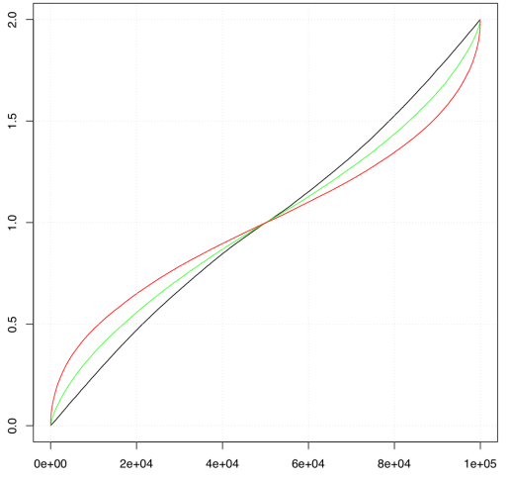
Impact of correlation on PML
Plot of the sum of the probability of two variables (each from 0 to 1) with correlations of 1.0 (black), 0.5 (green), and 0.0 (red). This corresponds to two points located at the same location, then two points close enough to be impacted by some but not all events, and finally far enough apart to be unaffected by the same events.
Events (100,000) vs. cumulative “losses”

Slide 7
Overview of Hurricane Loss Models
Input data bases
Wind Models
Surface Friction and Topography Adjustments
Damage Functions
Frequency of occurrence of events

Slide 8
Traditional Loss Models
Frequency Model
Land Cover
Topography
Data
Exposure
Data
Historical
Storm Data
Storm
Set
Wind
Model
Friction
Model
Damage
Function
Actuarial
Module
Loss
Costs
Historical data can be used directly, statistically smoothed, or otherwise analyzed to create a data base of storm characteristics used to create the storm set for simulations.

Slide 9
Methodology
Simulate all Atlantic storms (1851 to 2011; only using 1871 to 2011 for analysis
Run full physics tropical cyclone model
  SLOSH wind model with trajectory based boundary layer
  WISWAVE III wave model (incl. inshore refraction/breaking)
  5 layer hydrodynamic model (storm surge and riverine flooding)
  TRMM Climatology based rain model.
Determine losses on target portfolio
  Composite of multiple public domain damage functions (Watson and Johnson, 2004)
Modeled loss costs include wind (TS+), riverine flooding, and storm surge

Slide 10
Terminology and Comparison Criteria
Average Annual Loss (AAL)
Probable Maximum Loss (PML)
  Return period and frequency
PML/AAL
  Multiples of the annual premium that are required to cover the losses from an event of that return period
Plot: PML/AAL to Return Period

Slide 11
Variability and Uncertainty
Variability: What is the range of probable risk in a given year? In catastrophic risk this can be an enormous range – from zero to a large number. We usually look at this in terms of return periods, such as the 100 year event, or in annual terms, an event has a 1 in 100 chance of happening in a given year.
Uncertainty: How good are the estimates of the risk?

Slide 12
Experimental Results
  Hypothetical exposure at each ZIP Code centroid:
  Structure Value: $100,000
  Contents Value: $60,000
  Standard US Single Family Construction (WF)

Slide 13
Case 1: Single Location
Aggregating to zip code level

Slide 14
Case 2: Single Structure Combinations

Slide 15
Case 3: Multi-County Combinations

Slide 16
Realistic Exposure Results
  Exposure derived from 2010 American
  Community Survey at the Block Group level.

Slide 17
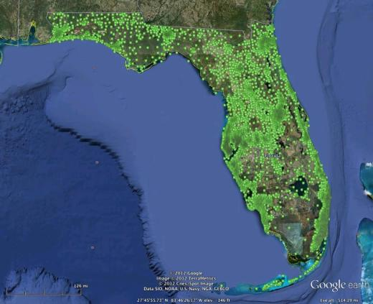
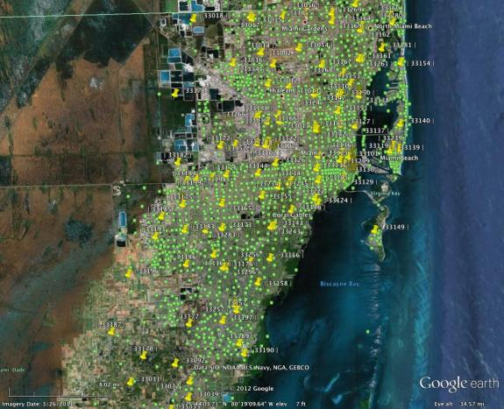
Florida ACS Exposure
Pushpins are ZIP Codes
Green dots are ACS BG Centroids
ACS data is approximately 10 times
as dense as ZIP Codes are in urban areas geographically. Diverse portfolio – Manufactured Housing, Wood Frame, Masonry, Duplexes, Condos, etc.

Slide 18
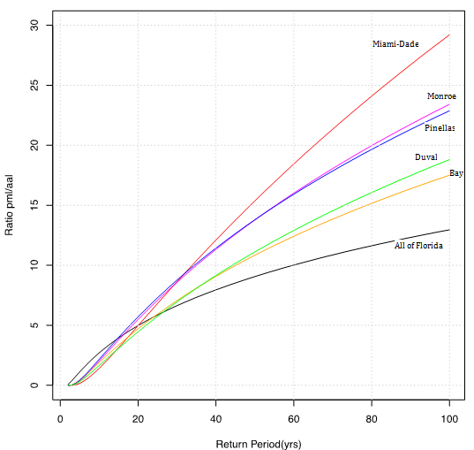
Performance of various Florida Portfolios

Slide 19
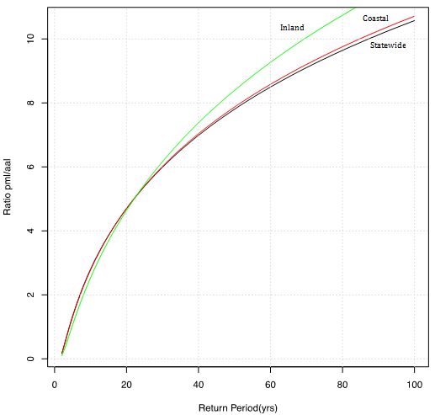
Florida Statewide, Inland and Coastal Portfolios

Slide 20
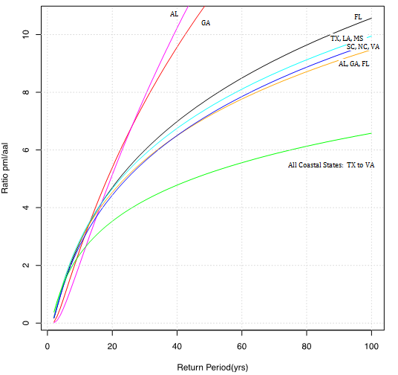
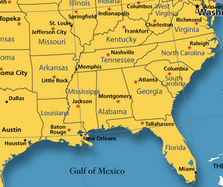
Individual States vs. Multi-state Groups

Slide 21
Uncertainty
How good are the loss estimates? This figure shows the range of possible values for the State of Florida (blue shaded area bounded by black lines), and for the entire coast from Texas t o Virginia (pink shaded area bounded by red lines). In both cases the shaded area represents the upper 90% and lower 10% prediction limits. In other words, there is a 10% chance the correct value is above the shaded area, and a 10% chance the correct value is below the shaded area.

Slide 22
Capacity required to cover a 100 year Loss
Territory | 100 Year Loss
Texas | $26,495,700,000
Louisiana | $18,337,501,250
Mississippi | $4,751,439,400
South Carolina | $5,624,569,400
North Carolina | $8,231,516,250
Virginia | $4,810,914,050
Florida | $49,483,235,000
Georgia | $3,349,056,550
Alabama | $8,955,484,400
Sum of each state: | $130,039,416,300
Multi-state Aggregate: | $71,110,875,000
Percent aggregate: | 54.7%
Ratio aggregate to individual | 1.83

Slide 23
Main Results
Clear benefit of pooling catastrophic wind risk more broadly
  Geographic diversification benefits for the less frequent/more severe events
    > 20-25 year return period
    54% of individual aggregate
  Benefit would accrue to all state combinations examined in this study.
    Natural boundaries instead of state borders
  Results are independent of premium: No subsidy issue
  Model transparency should help to address black box concerns
    Modeled loss results include storm surge

Slide 24
Implications and Future Direction
Pooling implications
  Two Tier System
    Multi-state (coastal) compact, national wind risk pools
  Challenges
    Need for long-term perspective
      AALs across time
      Year to year variation in experience across states
    Triggers and Managers
Future Direction
  Additional analysis related to diversification benefits
  Evaluate whether geographic diversification benefits exists for pools with different catastrophic exposures (i.e., wind, earthquake, flood).
Catastrophic Storm Risk Management Center
  www.strormrisk.org

Slide 25
Florida Commission on Hurricane Loss Projection Methodology

Slide 26
Hurricane Modeling Background
Traditional methods of projecting hurricane loss cost were considered inadequate after Hurricane Andrew.
Hurricane modeling provided a more scientific approach, but has been considered controversial due to the proprietary nature of the models.
The Legislature recognized the need for expert evaluation of computer models.

Slide 27
Creation of Florida Commission on Hurricane Loss Project
In 1995, the Florida Legislature created the 11 member Florida Commission on Hurricane Loss Projection Methodology (see s. 627.0628, F.S.)
  Administered out of the Florida Hurricane Catastrophe Fund
  State Board of Administration annually appoints the Chair
Panel of Independent Experts formed to:
  “provide the most actuarially sophisticated guidelines and standards for projection of hurricane losses possible,”
  “resolve conflicts among actuarial professionals,”
  “provide both immediate and continuing improvement in the sophistication of actuarial methods used to set rates.”
Notes:
Exactly what commission has been doing

Slide 28
Composition of the Commission
Three actuaries:
  OIR (appointed by Director of OIR)
  Insurance Industry (appointed by CFO)
  Actuary Member of the FHCF Advisory Council
Experts from the State University System (appointed by the CFO):
  Insurance Finance (Actuarial Science)
  Statistics (Insurance)
  Computer System Design
  Meteorology (Hurricanes)
Insurance Consumer Advocate
Executive Director of Citizens
Senior FHCF Officer
Director, Division of Emergency Management
Engineer to join Commission later this year

Slide 29
Principles
(Examples*)
All models or methods shall be theoretically sound.
Models or methods shall not be biased to overstate or understate results.
The output of models or methods shall be reasonable and the modeler shall demonstrate its reasonableness.
*See page 15 of the Report of Activities for the 20 Principles adopted by the Commission.

Slide 30
The Acceptability Process
30
Revising & Developing Standards
Reviewing Models
Jun
Jul
Aug
Sept
Oct
Nov
Dec
Jan
Feb
Mar
Apr
May
Jun
Planning Workshops
Report of Activities
Modelers Submissions Due
Commission Reviews Models
Commission Reviews Submissions
Professional Team & Staff Conference
Commission Meeting to Adopt Standards
On-Site Reviews by Professional Team
Committee Meetings to Revise Standards

Slide 31
The Professional Team
Inputs
Statistics
Meteorology
Expert Evaluation Requires:
Statistician
Meteorologist
Structural Engineer
Actuary
Computer Scientist
Engineering
Actuarial
Outputs
Computer Programming
Hurricane Computer Models

Slide 32
Requirements
 | General | Meteorological | Vulnerability | Actuarial | Statistical | Computer
Standards 36 (88 subparts) | 5 (8 subparts) | 6 (12 subparts) | 2 (9 subparts) | 10 (29 subparts) | 6 (7 subparts) | 7 (23 subparts)
Disclosures 144 | 28 | 33 | 11 | 38 | 27 | 7
Forms 26 | 7 | 3 | 3 | 8 | 5 | 0
On-Site Audit Requirements 142 | 13 | 28 | 10 | 33 | 29 | 29

Slide 33
For More Information
FCHLPM Web Site:
WWW.SBAFLA.COM/METHODOLOGY
RDUMM@FSU.EDU

