Slide 1
Agricultural Insurance and the urban-rural income gap -- Based on a dynamic panel model of the GMM estimation
Tan Yi
Yuan Yuan
School of Insurance, Central University of Finance and Economics
Beijing, China
July 19, 2013

Slide 2
Outline of Topics
Introduction
Review of Literatures
Variables and Model
The analysis of the results
Conclusion
Reference

Slide 3
Introduction
Review of Literatures
Variables and model
The analysis of the results
Conclusion
The motivation of the research
Method and data
The motivation of the research
In 2007, China‘s ministry of finance released “The central finance agricultural insurance premium subsidies pilot management approach”
Agricultural insurance's premium income in 2007-2011 respectively was 50.54 billion, 109.52 billion, 132.83 billion, 133.55 billion, 176.04billion.
Agricultural insurance's premium income was 11.94 billion in total from 1980 to 2006.
Premium income in 2011 was 1.47 times the sum of the premium for the past 27 years.
The intention of agricultural insurance is to use the risk transfer mechanisms to stabilize farmers' income and narrow the urban-rural income gap.
Therefore, the paper tries to answer "Agricultural insurance can narrow the urban-rural income gap or not", which based on the model of the GMM dynamic panel estimation methods.

Slide 4
Introduction
Review of Literatures
Variables and model
The analysis of the results
Conclusion
The motivation of the research
Method and data
Method and data
Dynamic panel model: Fixed effect model and Random effect model
System General Method of Moments(SYS-GMM): In order to overcome the problem of endogeneity
2007-2012 Yearbook of China Insurance
2007-2012 Yearbook of China Statistical

Slide 5
Introduction
Review of Literatures
Variables and model
The analysis of the results
Conclusion
Agricultural insurance
Urban-rural income gap
Agricultural insurance
Firstly, the agricultural insurance can reduce the urban-rural income gap
Secondly, agricultural insurance can transfer a poor and pure internal risk to the outside, in order to avoid rural residents into deeper poverty.
Finally, the agricultural insurance can effectively reduce the risk of credit default and make it possible for farmers to loan.
Gao Jie (2008) The results showed that agricultural insurance expenses have on impact on farmers' income, which did not show a positive relationship of the theory that agricultural insurance on farmers' income.
Liang Ping et al (2008) The paper found that agricultural insurance and income of farmers had a long-term cointegration relationship by VECM model. And agricultural insurance was the granger causes of farmers' income growth.

Slide 6
Introduction
Review of Literatures
Variables and model
The analysis of the results
Conclusion
Agricultural insurance
Urban-rural income gap
Urban-rural income gap
The first theory is urbanization.
The structure of urban-rural’ urbanization has a huge difference. China's urbanization process is so slow that enlarges the urban-rural income gap (Lu Ming and Chen Zhao, 2004; Zhou Yunbo, 2009; Liu Tian, 2013)
The second theory is government.
The government did not pay adequate support to farmers, such as educational resources, social security and so on.( Li Wei and Lu Ming, 2005; Tian Shichao, 2007; Jane must Maki, 2013)
The third is financial theory.
Financial development is not balanced, and it will not help to optimize the efficiency of resource allocation. (Sun Yongqiang and Wan Yulin, 2011; Ye Zhiqiang, Chen Xi and Zhang Shunming, 2011)

Slide 7
Introduction
Review of Literatures
Variables and Model
The analysis of the results
Conclusion
Variables
Model
Variables
Variable | Variable | Variable Meaning | Method
Dependent | gap | Income gap | Urban residents' disposable income/ net income of rural residents
Independent | claim | insurance claims | Total agricultural insurance claims
Control | gdp | Gdp per capita | GDP/total population
 | fi | Per capita investment in fixed assets | Investment in fixed assets/ total population
 | edu | Per capita investment in education funding | Education funding / total population
 | tra | Per capita traffic mileage | Road and rail mileage / total population
 | ubr | Urbanization | Non-agricultural population/total population
 | open | Openness | Total imports and exports / GDP
 | nonsoe | Ownership Structure | Non-state-owned employment/ employment
 | gov | Expenditure | Expenditure / GDP

Slide 8
Introduction
Review of Literatures
Variables and Model
The analysis of the results
Conclusion
Variables
Model
The basic characteristics of data variables
Variables | Name | Mean | S | Min | Max
Dependent | lngap | 1.1043 | 0.1827 | 0.7264 | 1.5036
Independent | lnclaim | 4.3998 | 1.8636 | -2.8134 | 6.9637
Control | lngdp | 0.9522 | 0.5144 | -0.2305 | 2.1216
 | lnfi | 0.4341 | 0.4842 | -0.8918 | 1.6517
 | lnedu | -2.4790 | 0.4586 | -3.3578 | -1.3561
 | lntra | 3.4278 | 0.6476 | 1.6760 | 5.3462
 | lnubr | -0.7433 | 0.2823 | -1.4867 | -0.1131
 | lnopen | -1.7201 | 1.0065 | -3.3490 | 0.5095
 | lnnonsoe | -.1398 | 0.0827 | -0.5525 | -0.0544
 | lngov | -1.6157 | 0.4842 | -2.4368 | 0.2242

Slide 9
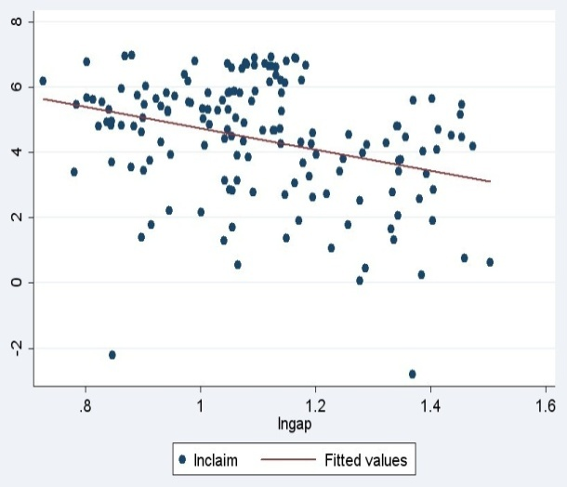
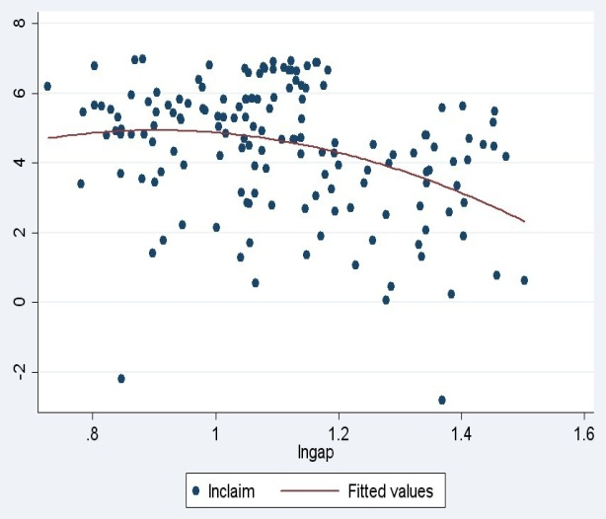
Introduction
Review of Literatures
Variables and Model
The analysis of the results
Conclusion
Variables
Model
Figure 1 and Figure 2
Figure 1 and figure 2 showed that agricultural insurance and the income gap may exist certain a linear relationship. In the following paragraphs, we will analyze the relationship based on GMM estimation.

Slide 10
Introduction
Review of Literatures
Variables and Model
The analysis of the results
Conclusion
Variables
Model
Model
In order to accurately quantify the impact of urban-rural income gap factors, we refer to Lu Ming and Chen Zhao (2004), Clarke et al. (2006), Beck et al. (2007) and other studies of urban-rural income gap model.

Slide 11
Introduction
Review of Literatures
Variables and model
The analysis of the results
Conclusion
Regression results-1
Table 1 Agricultural insurance and Urban-rural income gap
Variable | OLS (1) | RE (2) | FE (3) | GMM (4) | GMM (5) | GMM (6)
L.lngap | - | - | - | 0.3224*** （8.74） | 0.3304*** （22.07） | 0.2495*** （3.03）
lngdp | -0.1091 （-1.57） | -0.2749** （-1.57） | -0.2736** （-2.41） | -0.2076*** （-22.61） | -0.4377*** （-11.07） | -0.4002*** （0.29）
lnclaim | -0.0143* （-1.83） | -0.0143*** （-1.83） | -0.0139** （-2.29） | -0.0106*** （-3.32） | -0.0061** （-2.28） | -0.0051*** （0.99）
lnfi | -0.1091 （-1.53） | -0.1091** （-1.53） | -0.1181** （-2.39） | -0.1763** （-14.10） | -0.1788*** （-8.74） | -0.2459*** （-7.65）
lnedu | 0.2561** （2.47） | 0.2561*** （2.47） | 0.2877*** （3.21） | -0.0036 （-0.27） | 0.3899*** （15.14） | 0.3813*** （4.54）
lntra | 0.0412 （0.84） | 0.0412 （0.84） | 0.0434 （1.64） | -0.0020 （-0.12） | -0.0193** （-2.43） | -0.0963*** （-2.95）
lnubr | 0.0125 （0.07） | 0.0125 （0.07） | 0.0006 （0.01） | - | -0.0785 （-1.44） | -0.0869 （-0.86）
lnopen | 0.0523* （-1.81） | 0.0523*** （-1.81） | 0.0558*** （-3.31） | - | 0.0427*** （-5.71） | 0.0252*** （-3.84）
lnnonsoe | 0.3789* （2.00） | 0.3789*** （2.00） | 0.4134** （2.53） | - | 0.2963* （1.96） | 0.3984 （1.22）
lngov | -0.1274 （-1.38） | -0.1274* （-1.38） | -0.1451** （-2.12） | - | -0.2994*** （-19.68） | -0.1832*** （-2.75）
Sargan test | - | - | - | 0.221 | 0.396 | 0.349
Hansen test | - | - | - | 0.274 | 0.113 | 0.228
AR(2) test | - | - | - | 0.181 | 0.515 | 0.160
Province | 31 | 31 | 31 | 31 | 31 | 28
Note: ***, **, * represent 1%, 5%, 10% significant level.

Slide 12
Introduction
Review of Literatures
Variables and model
The analysis of the results
Conclusion
Regression results-1
Table 1 Agricultural insurance and Urban-rural income gap
The summary of regression results
whether it is mixed regression, random effects regression or fixed effects regression, agricultural insurance and income gap have the negative correlation.
Agricultural insurance and income gap
The quantitative analysis of the impact of agricultural insurance on income gap is also quite significant.
Control variables and income gap
Economic development(-0.4377) , investment(-0.1788), tra(-0.0193), gov(-0.2944)
Education(0.3899), Open (0.0427) and ownership structure(0.2953)

Slide 13
Introduction
Review of Literatures
Variables and model
The analysis of the results
Conclusion
Regression results-2
The internal mechanism
Through the above analysis, we found that agricultural insurance will reduce the urban-rural income gap. But we are not sure of specific mechanisms that how agricultural insurance affect the urban-rural income gap.
In order to accurately grasp the mechanisms, we must examine the relationship between agricultural insurance and income growth.
In order to control regional fixed effects, time fixed effects and endogeneity, we follow the model (3).

Slide 14
Introduction
Review of Literatures
Variables and model
The analysis of the results
Conclusion
Regression results-2
Table 2 The internal mechanism
Variable | GMM (1) | GMM (2) | GMM(3)
 | lnrural | lnurban | lngdp
L. | 0.3437*** （5.71） | 0.0499** （0.73） | 0.0040* （0.21）
lngdp | 0.1576*** （2.26） | 0.4117*** （6.72） | -
lnclaim | 0.0102** （0.32） | 0.0022 （0.60） | 0.0009*** （0.03）
lnfi | 0.1468*** （3.78） | 0.3276*** （5.61） | 0.3034*** （5.12）
lnedu | -0.2758*** （-4.02） | 0.1051** （2.19） | 0.6357*** （27.39）
lntra | -0.0680*** （-3.31） | -0.1032*** （-7.25） | 0.0017 （0.20）
lnubr | -0.0235 （-0.33） | -0.1986*** （-3.76） | 0.4227*** （9.92）
lnopen | 0.0048*** （0.84） | 0.0631*** （5.03） | 0.0283*** （6.16）
lnnonsoe | 0.5527*** （4.17） | 0.8157*** （8.26） | 0.1672 （3.87）
lngov | 0.3352*** （6.54） | 0.0221 （0.62） | 0.4575*** （-6.82）
Sargan test | 0.364 | 0.174 | 0.169
Hansen test | 0.178 | 0.245 | 0.114
AR(2) | 0.132 | 0.171 | 0.390
Province | 31 | 31 | 31
Note: ***, **, * represent 1%, 5%, 10% significant level.

Slide 15
Introduction
Review of Literatures
Variables and model
The analysis of the results
Conclusion
Regression results-2
Table 2 The internal mechanism
Lnrural: Insurance claims plays a significant positive effect on rural per capita income growth.
One of the functions of insurance is the economic compensation. Agricultural insurance claims can compensate farmers’ economic losses which caused by the natural disasters. On the other hand, agricultural insurance is good for stabling and sustaining the development of agriculture. Therefore, agricultural insurance claims can indirectly stable the income of rural residents, which results in narrowing income gap.
Lnurban: The results show that there is no significant correlation between agricultural insurance and urban per capita income.
The reason why is that the agricultural insurance is mainly related to agriculture, and the city basically does not conduct with agricultural production.
Agricultural insurance claims has a significant positive correlation GDP per capita.

Slide 16
Introduction
Review of Literatures
Variables and model
The analysis of the results
Conclusion
Regression results-3
Agricultural insurance and Economic development
In table 2, all of the regression equation, agricultural insurance has a significant negative effect on urban-rural income gap after the per capita income(gdp) as a controlled variable.
Therefore, we put forward the following question:
When we treat gdp as economy development and remove it , whether the negative effect of agricultural insurance on the income gap depend on economy development or not?

Slide 17
Introduction
Review of Literatures
Variables and model
The analysis of the results
Conclusion
Regression results-3
Table 3 Estimation
Variable | OLS (1) | RE (2) | FE (3) | GMM (4) | GMM (5)
L.lngap | - | - | - | 0.3244*** （4.60） | 0.3271*** （4.71）
lnclaim | -0.0153* （-1.85） | -0.0153*** （-2.97） | -0.0162*** （-2.65） | -0.0126*** （-2.43） | -0.0082*** （-2.71）
lnfi | -0.1729*** （-3.24） | -0.1729*** （-4.37） | -0.1842*** （-4.41） | -0.1128*** （-4.22） | -0.1271*** （-22.24）
lnedu | 0.0917 （-3.24） | 0.0917* （1.85） | 0.1179** （2.09） | -0.0625** （-2.26） | 0.1185*** （8.54）
lntra | 0.0313 （0.63） | 0.0313 （1.21） | 0.0344 （1.29） | 0.0610*** （4.14） | -0.0326** （-2.15）
lnubr | -0.1231 （-0.78） | -0.1231 （-1.61） | -0.1329** （-1.68） | - | -0.2737 （-9.40）
lnopen | 0.0621* （-1.99） | 0.0621*** （-3.90） | 0.0642*** （-3.83） | - | 0.0636** （-8.20）
lnnonsoe | 0.3525* （1.83） | 0.3525*** （2.71） | 0.3484** （2.13） | - | 0.2464*** （3.65）
lngov | 0.0004 （0.01） | 0.0004 （0.01） | -0.0205 （-0.45） | - | -0.0737* （-7.55）
Sargan test | - | - | - | 0.355 | 0.114
Hansen test | - | - | - | 0.351 | 0.213
AR(2) test | - | - | - | 0.263 | 0.563
Province | 31 | 31 | 31 | 31 | 31
Note: ***, **, * represent 1%, 5%, 10% significant level.

Slide 18
Introduction
Review of Literatures
Variables and model
The analysis of the results
Conclusion
Regression results-3
Table 3 Analysis
Firstly, it is still a negative correlation between agricultural insurance and rural-urban income gap. This means that when we removed the controlled variable of gdp, the result is still significant.
Secondly, compared to table 1 and table 2, whether to join the per capita income variable or not, the agricultural insurance also has significant negative correlation with urban-rural income gap.
In short, the negative effect of agricultural insurance on the income gap is not dependent on the level of economic development.

Slide 19
Introduction
Review of Literatures
Variables and model
The analysis of the results
Conclusion
Conclusion
Conclusion
The empirical results show that China's agricultural insurance significantly narrows the urban-rural income gap.
Inner mechanism Agricultural insurance claims have a significant positive correlation with the rural per capita income, but have no significant correlation with the urban per capita income.
However, due to the development of agricultural insurance is relatively backward, uneven regional development, the level of protection is limited. And the development of agricultural insurance can’t effectively meet the farmers’ need of responding to major natural disasters. Therefore, this role is also very weak.

Slide 20
Reference
[1]Ramaswam,i B.Supply Response to Agricultural Insurance: Risk Reduction and Moral Hazard Effects[J].American Journal of Agricultural Economics, 1993, 75: 914- 925.
[2]Mosley, P. and Krishnamurthy, R. Can crop insurance work? The case of Indian[J].Journal of Development Studies, 1995, 31(3): 428- 450.
[3]Ming Lu, Zhao Chen. Urbanization, Urban-Biased Economic Policies and Urban-Rural Inequality[J]. Economic Research Journal，2004，(6):50-58.
[4]Zhou Yunbo.Urbanization,Urban-Rural Income Gap and Overall Income Inequality in China:An Empirical Test of the Inverse-U Hypothesis[J]. China Economic Quarterly，2009，(4):1240-1256.
[5]LIU Tian.Analysis of Impact Factors and Inverted U-Shape Test of Chinese Urban-Rural Income Gap Based on Theil’s Index[J]. Modern Economic Science，2013，(1):1-8.
[6]Ding Weili and Lu Ming.Do We Have to Choose between Justice and Efficiency in Education?The General Equilibrium Economics of the Financing of Basic Education[J]. Social Sciences In China，2005，(6):47-57.
[7]Tian Shichao and Ming Lu. Contribution of Education to Within-Space Income Inequality:Evidence from Shanghai Household Data[J].South China Journal of Economics，2007，(5):12-21.
[8]Jian Bixi and Ling Guangjie. Education Comparative study of heterogeneous returns [J]. Economic Research Journal, 2013, (2) :83-95.
[9]Wang Jianxin and Huang Pe. Financial Development and Income Distribution:Based on the Data Investigation of China’s 29 Provinces[J]. Shanghai Journal of Economics，2009，(11):3-13．
[10]Sun Yongqiang and Wan Yulin. Financial Development,Opening-up and Urban-rural Income Gap:Empirical Analysis Based on the Panel Data from 1978 to 2008[J]. Journal of Financial Research，2011，(1):28-39．
[11]Gao Jie. Agricultural insurance for farmers' income and its policy implications[J]. Public Finance Research，2008，(6):48-51.
[12]Liangping, Liangpeng Yong, Dong Yuxiang. Agricultural Insurance and Farmers' Income Research Experience[J]. Modernization of Management，2008，(1):46-48.
[13]Clarke, R. G., Lixin Colin Xu and Hengfu Zou,2006,” Finance and income inequality; What do the data tell us?” Southern economic journal , 72, 3,578-96.
[14]Beck, Thorsten, Asli Demirgii-Kunt and Ross Levine, 2007,"Finance,inequality and the poor," Journal of Economic Growth,12, 1,27-49.

Slide 21
Thanks!

