Slide 1
2013 Retirement Readiness Index Survey
2013退休准备指数调研
Marco Groot Wassink
华宇轩
EVP, Aegon-CNOOC
海康人寿执行副总经理
July. 20th , 2013
2013年7月20日

Slide 2
Background
背景
Key Findings
调研结果
Advice from Aegon-CNOOC
海康人寿的建议

Slide 3
Background
背景

Slide 4
Aegon Retirement Readiness Index Survey
Aegon退休准备指数调研
The 2nd year
第二年
12 countries
12个国家
12,000 samples
12,000个样本

Slide 5
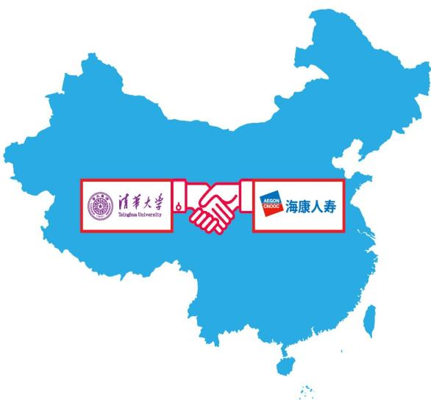
China Retirement Readiness Index Survey
中国居民退休准备指数调研
The 1st year
第一年
5 cities
5个城市
1,060 samples
1,060个样本

Slide 6
About Retirement Readiness Index 关于退休准备指数
Definition 定义
Retirement Readiness Index (RRI) is a score which measures people’s awareness and financial preparedness for retirement.
退休准备指数(RRI)是对居民个人为满足其退休需要所进行的财务准备的充足性和理财意识的感知程度的评估
RRI is calculated based on six key measures 指数关键考核指标
Personal responsibility 个人责任
Level of awareness 意识水平
Financial capability/Understanding 财务理解能力
Retirement planning 退休规划
Financial preparedness 财务准备
Income replacement 收入替代率

Slide 7
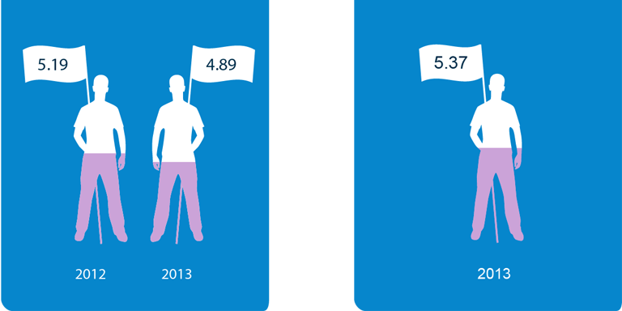
China RRI score 中国居民退休准备指数
China RRI score (5.37) is above the average of the global result, ranking the 2nd among 12 countries.
中国居民退休准备指数（5.37）高于全球平均水平，在12个国家中位居第二。
Aegon RRI (average)
Aegon退休准备指数（平均分）
China RRI
中国居民退休准备指数

Slide 8
Insights of China RRI score 对中国居民退休准备指数的解读
Reasons for the fact that 2013 China RRI score is higher than the average (4.89) of Aegon global results:
中国居民2013年的退休准备指数高于全球12个国家的平均水平4.89，可能的原因是：
Chinese citizens are over confident and positive towards their financial awareness, financial understanding, etc.
中国居民对退休生活的主观认知有过于乐观的倾向，比如财务规划认知水平、财务理解能力等
Chinese citizens have a tradition of saving, which exactly accounts for a large proportion of RRI score calculation. In fact, their actions for retirement planning lag far behind what American, Japanese and Europeans do.
中国居民具有储蓄的传统，恰好储蓄在退休准备指数的计算中占到了最大比重。实际上，中国人在退休规划及行动层面落后于美国、日本和许多欧洲国家
Chinese citizens have an excessive reliance on social basic pension and positively regard it as a reliable approach.
中国居民对社会养老保险这种传统的养老金来源过分依赖，并且乐观地认为由政府提供的社会养老保险很可靠，从而提升了对于退休准备的信心

Slide 9
Key findings of China RRI Survey
中国居民退休准备指数调研结果

Slide 10
Positive Aspiration for Retirement 中国居民退休生活预期普遍较高 vs. Low confidence in Achieving Expected Retirement Income 对取得期望退休收入缺乏信心

Slide 11
Aspiration 对退休生活的期望
Q: Which of the following words do you most associate with retirement?
问：请问您最有可能将下列哪些词语与退休联系在一起？
Most people expect their life in retirement associated with enjoyment, leisure and freedom.
大部分受访者将退休生活与“享受生活”、“悠闲”和“自由”联系在一起。

Slide 12
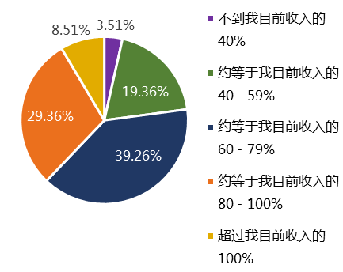
Expected Retirement Income 预期退休收入
Q: Thinking about what money can buy today, what gross annual income do you expect to need in retirement, as a proportion of your current earnings?
问：考虑通货膨胀，您期望退休后，每年的总收入占您目前收入的多少？（总收入是您期望税前能取得的收入）
9%
4%
Less than 40% of what I currently earn
19%
About 40 - 59% of what I currently earn
29%
About 60 - 79% of what I currently earn
39%
About 80 - 100% of what I currently earn
More than 100% of what I currently earn
Most people expect to get 60-79% of what they currently earn as retirement income.
大部分受访者希望退休后的收入是目前收入的60%-79%。

Slide 13
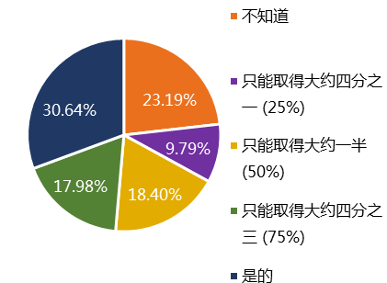
Confidence in Achieving Expected Retirement Income 对取得预期退休收入的信心
Q: Do you think you will achieve the retirement income as expected?
问：您觉得自己将来能取得这些期望的退休收入吗？
I don’t know if I am on course to achieve my retirement income
31%
23%
No, I am on course to achieve around one-quarter (25%) of my retirement income
10%
18%
No, I am on course to achieve around half of my retirement income
18%
No, I am on course to achieve around three-quarters (75%) of my retirement income
Yes, I am on course to achieve my retirement income
However, most people are not confident in achieving retirement income as expected.
然而，大部分受访者对取得这些期望的退休收入表示没有信心。

Slide 14
High Awareness of Retirement Responsibility 中国居民认为退休最需要靠自身 vs. Traditional and Limited Retirement Income Sources 退休收入来源仍较为传统和单一

Slide 15
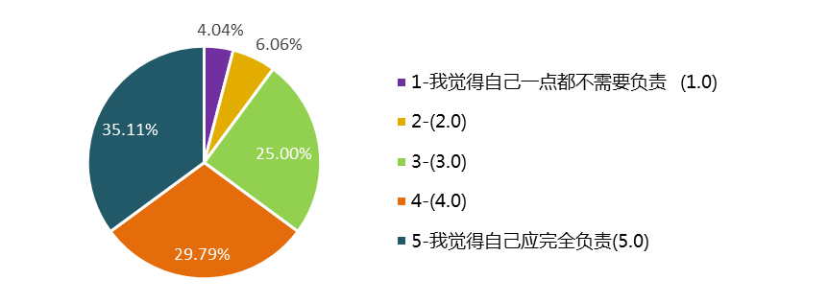
Retirement Responsibility 对退休后谁来承担经济保障责任的认知
Q: To what extent you should be responsible for the sufficient income in retirement?
问：您在多大程度上觉得您自己应当负责和确保退休后有足够的收入？
4%
6%
1- I don’t feel responsible at all (1.0)
35%
25%
30%
5- I feel very responsible (5.0)
Most people feel responsible for the sufficient income in retirement.
大部分受访者认为自己应当对退休后有足够的收入负责。

Slide 16
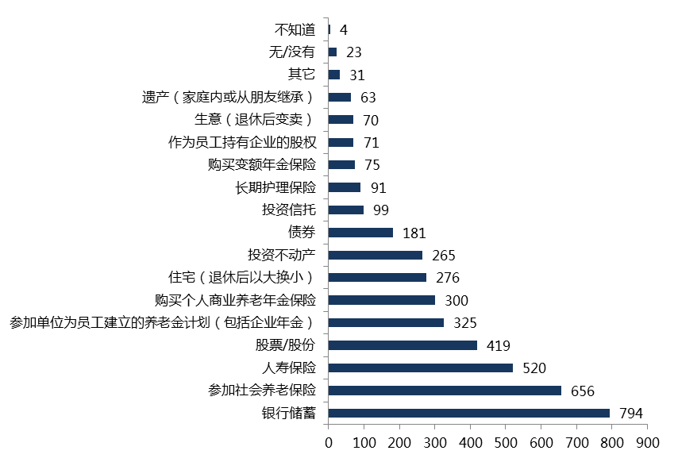
Retirement Income Sources 退休收入来源
Q: Which financial means are you currently using to prepare for your retirement?
问：您目前采用了哪些理财工具（如有）来为今后退休做准备？
Don’t know
0%
None
2%
Other
3%
Inheritance (from my parents or
other family and friends)
6%
My business (which I intend to sell at retirement)
7%
Employee stock purchase plan
7%
Annuities
7%
Long-term care insurance
9%
Mutual funds
9%
Bonds
17%
Investment property
25%
My home (which I intend to downsize at retirement)
26%
Individual commercial pension insurance
28%
A company-funded
defined benefit pension plan
31%
Stocks
40%
Life insurance
50%
Pension insurance
62%
Bank savings
75%
However, most people only reply on two traditional retirement income sources, i.e. bank savings and social basic pension.
然而，大部分受访者目前仅采用两种传统的方式：银行储蓄、参加社会养老保险。

Slide 17
Strong Needs for Retirement Saving 退休储备的需求强烈 vs. Insufficient Retirement Planning 缺乏完善的退休规划

Slide 18
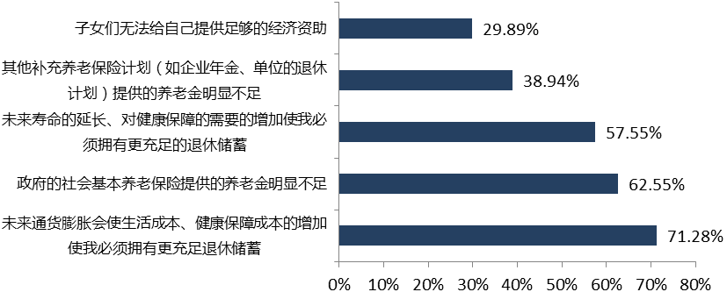
Needs for Retirement Saving 退休储备的需求
Q: For what reasons you save for retirement?
问：哪些原因能激励人们为未来退休进行储备 ？
30%
Children could not provide sufficient economic support
39%
Supplementary pension plans is not sufficient
58%
The prolonged life expectancy and increasing needs of health protection
62%
The social basic pension is not sufficient
71%
Increasing living and health cost caused by inflation
People save for retirement mainly due to insufficient social basic pension, increasing living and health cost caused by inflation, prolonged life expectancy and increasing needs of health protection.
人们为退休生活储备主要由于：社会基本保险金不足，未来通胀导致生活成本和健康保障成本的增加,未来寿命的延长，对健康保障的需要的增加。

Slide 19
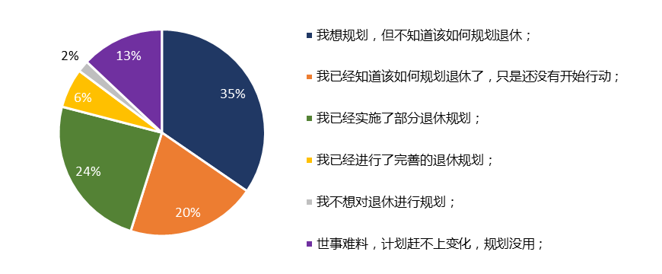
Retirement Planning 退休规划
Q: Which describes the status of your retirement planning?
问：下列哪一项最确切地表述了您在制定退休规划方面的情况？
I want to plan, but don’t know how
I know how to plan, but haven’t take actions yet
I have take full actions for retirement planning
I have take some actions for retirement planning
I don’t want to plan for retirement
Changes run faster than plans. It is useless to plan for retirement
However, only 24% of the respondents have a good retirement plan, and the majority (55%) still have no idea about it and haven’t taken any actions.
然而，只有24%的受访者有完善的退休规划，大部分人（55%）仍不知道如何规划或者还没有开始行动。

Slide 20
Advice from Aegon-CNOOC
海康人寿的建议

Slide 21
It is an emerging global crisis
这是一个全球性的危机
No country’s RRI score is higher than 6.
目前，没有一个国家的准备指数超过6分。
5.37
Score:6
6分
5.19
4.89
2012
2013

Slide 22
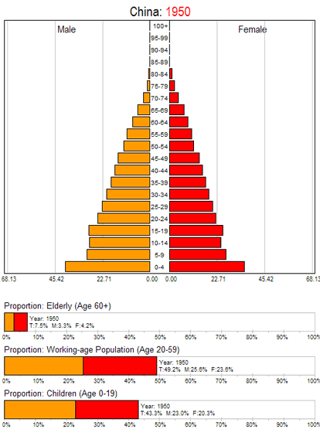
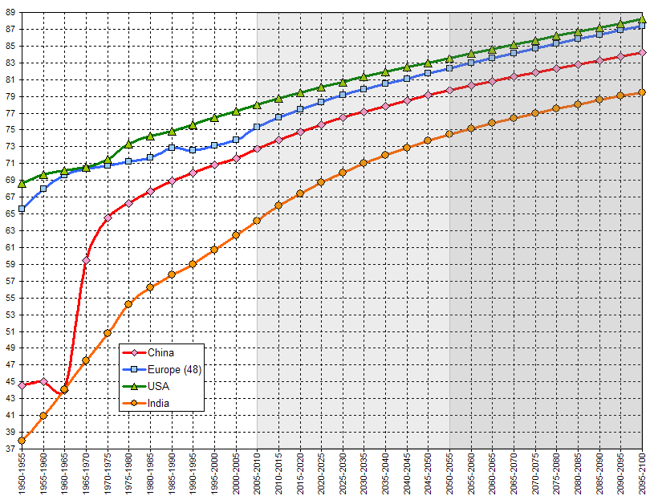
The coming of aging society
老龄化社会的到来
With the increasing of average life expectancy, the problem of aging society is becoming prominent.
随着预期平均寿命的延长，老龄化社会的问题日益突出。
美国
欧洲
中国
2050年:
79 岁
印度
2013年:
74 岁
Source : United Nations
数据来源: 联合国

Slide 23
%
What does aging society
mean to retirement?
老龄化社会对养老意味着什么？
87.6%
Chinese dependency ratio in 2010 was 38.2%, and it is on the rise.
According to estimation, it will reach 87.6% in 2050.
2010年，中国人口抚养比为38.2%，并呈持续上升趋势。2050年，预计上升至87.6%
38.2%
2010
2050
SOURCE: World Bank
数据来源：世界银行
*Dependency ratio=(number of non-working age population) ÷ (number of working age population) ×100%
*人口抚养比=（非劳动年龄人口÷ 劳动年龄人口） ×100%

Slide 24
How much can Chinese citizens
get after retirement?
中国居民能有多少退休收入？
Government
政府
According to the suggestions by World Bank, retirement income should account for 70% of the pre-retirement income.
世界银行建议，一个人的养老收入至少要达到退休前收入的70%。
Chinese citizens’ retirement income
Employer
企业
Individual
个人

Slide 25
Gap between the ideal and reality
理想与现实有差距
We should rely on our own to achieve high-quality retirement life.
维持生活品质、提高退休境遇还需靠自己
Government
政府
Low replacement rate
替代率低
Individual
个人
Fill in the gap
弥补缺口
Employer
企业
Limited coverage
覆盖面有限
Notes:
Pension Replacement Rate=Retirement income ÷Income before retirement×100%
养老金替代率，是指劳动者退休时的养老金领取水平与退休前工资收入水平之间的比率。

Slide 26
How to fill in the gap for retirement planning?
个人如何来填补无忧养老的缺口？
Needs for good retirement life
居民无忧养老的需求
Advantage of commercial annuity products
商业养老保险的优势
A guaranteed income…
一笔保证收入 …
Stable returns,
guaranteed payment
本金安全，稳定收益，
保证领取
… as long as I’m alive
… 只要我还活着
Whole life payment
可终身领取
Notes:
26

Slide 27
Suggestions for retirement planning
我们对于消费者养老规划的建议
Wealth 财富
Protection stage
保障阶段
Accumulation stage
积累阶段
Retirement stage
退休阶段
Age 年龄
Protection stage 保障阶段 | Accumulation stage 积累阶段 | Retirement stage 退休阶段
Needs
主要需求
Protection for life and property
High investment returns
Wealth heritage, medical coverage
保障人身、财务安全
高投资回报率
财富传承、医疗保障
Products
对应产品
ADD, health-related product, P&C
Annuity, CI, Investment-related product
Annuity, CI, LTC
意外险、健康险、财产险
养老、重疾、投资
养老、重疾、长期护理

Slide 28
Insurance companies play an active
role on retirement planning
保险公司在解决养老问题上发挥积极作用
Listening 聆听
Communicating 沟通
Satisfying 满足
Sharing 分享
Notes:
Listening to customers
Do customer survey regularly, such as this retirement readiness index survey, and NPS survey which we have done for three times.
Communicating with customers
Increase customers' awareness on retirement financial planning by daily communication by agents/financial advisors/business partners with customers.
Cooperate with employers, and offer financial training to employees.
Call for action of retirement planning via mass media and other promotion activity
Developing products which satisfy customers’ needs
Aegon provides many products to support customers’ retirement planning, such as annuities, variable annuities, individual and group pension in America, Britain and Netherland.
Based on Aegon’s rich experience, Aegon-Cnooc is also actively developing different kinds of products to support customers’ retirement planning, such as:
Endowment
Annuity
CI & medical product
Sharing experience
We keep a close contact with regulatory organization, and share the industry information as well as Aegon’s advanced experience in pension field.
We also share the survey report to the public via mass media to provide useful and feasible suggestions on financial planning.
28

Slide 29
We exist to help people take responsibilities for their financial future.
我们致力于帮助客户未雨绸缪，实现财务保障，安享未来。

Slide 30
Thanks! 谢谢！

